Slide 1



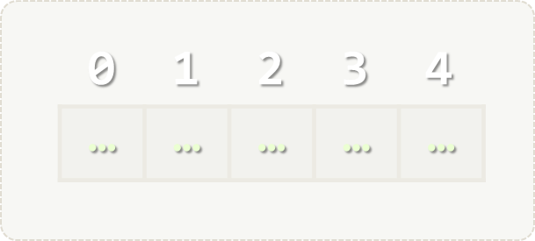
Array and List Algorithms
Manipulating Arrays and Lists
Arrays
Lists
SoftUni Team
Technical Trainers
Software University
http://softuni.bg

Slide 2

Table of Contents
Array Algorithms
Sorting Algorithms
Bubble Sort
Insertion Sort
List Algorithms

Slide 3
Questions?
sli.do #extended-softuni

Slide 4
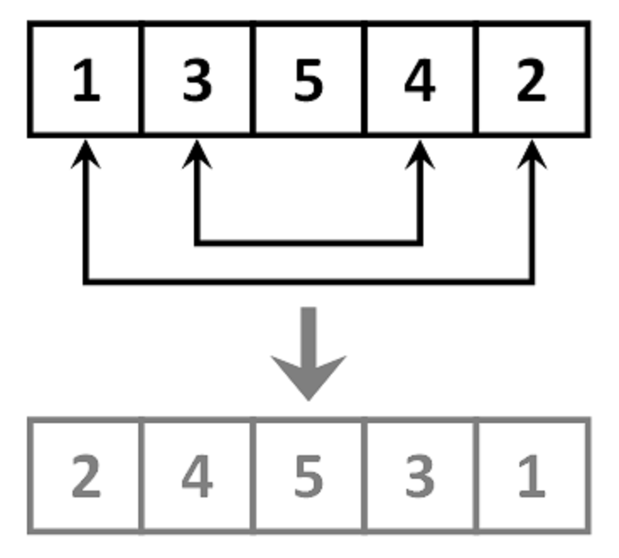
Array Algorithms
Manipulating, searching, sorting

Slide 5
Problem: Array Contains Element
Write a program which checks if element is contained in array:
5
1 2 3 4 5
yes
11
8 7 7 9 6 2 2
no
2314
99 7 8 6 2314 2
yes

Slide 6
Solution: Array Contains Element
var element = int.Parse(Console.ReadLine());
var arr = Console.ReadLine()
.Split().Select(int.Parse).ToArray();
var containsElement = false;
for (int i = 0; i < arr.Length; i++)
if (arr[i] == element)
containsElement = true; break;
if (containsElement)
Console.WriteLine("yes");
else
Console.WriteLine("no");
Check your solution here: https://judge.softuni.bg/Contests/Practice/Index/426#0/

Slide 7
Problem: Smallest Element in Array
Write a program that finds the smallest element in an array:
1 2 3 4 5
1
9 8 7 82 78 13
7
78 77 1268 43 9
9

Slide 8
Solution: Smallest Element in Array
var arr = Console.ReadLine()
.Split().Select(int.Parse).ToArray();
var min = int.MaxValue;
for (int i = 0; i < arr.Length; i++)
{
if (arr[i] < min)
{
min = arr[i];
}
}
Console.WriteLine(min);
Check your solution here: https://judge.softuni.bg/Contests/Practice/Index/426#1/

Slide 9
Problem: Reverse Array in Place
Write a program which reverses an array without using a second collection (like List<T>, etc…)
1 2 3 4 5
5 4 3 2 1
1 4 2 7 6 1 1
1 1 6 7 2 4 1
11 52 43 12 1 6
6 1 12 43 52 11

Slide 10
Solution: Reverse Array in Place
var arr = Console.ReadLine()
.Split()
.Select(int.Parse)
.ToArray();
for (int i = 0; i < arr.Length / 2; i++)
{
var temp = arr[i];
arr[i] = arr[arr.Length - 1 - i];
arr[arr.Length - 1 - i] = temp;
}
Console.WriteLine(string.Join(" ", arr));
Check your solution here: https://judge.softuni.bg/Contests/Practice/Index/426#2

Slide 11

Array Algorithms – Exercises
Live Exercises in Class (Lab)

Slide 12
Sorting Algorithms
Bubble sort, Insertion sort, etc…

Slide 13
What is a Sorting Algorithm?
Sorting algorithm
An algorithm that rearranges elements in a list
In increasing order
Elements must be comparable

Slide 14

Sorting – Example
Efficient sorting algorithms are important for
Producing human-readable output
Canonicalizing data – making data uniquely arranged
In conjunction with other algorithms, like binary searching
Example of sorting:
Unsorted list
sorting
Sorted list
10 | 3 | 7 | 3 | 4
3 | 3 | 4 | 7 | 10

Slide 15
Bubble Sort
Bubble sort – simple, but inefficient algorithm (visualize)
Swaps to neighbor elements when not in order until sorted
Example:

Slide 16
Problem: Sort Array Using Bubble Sort
Write a program which sorts an array using Bubble Sort :
5 3 4 1 2
1 2 3 4 5
11 872 673 1 2
1 2 11 673 872
11 52 43 12 1 6
1 6 11 12 43 52

Slide 17
Solution: Sort Array Using Bubble Sort
// todo: read input
bool swapped;
do
{
swapped = false;
for (int i = 0; i < arr.Length - 1; i++)
{
if (arr[i] > arr[i + 1])
{
Swap(arr, i, i + 1); // todo: write swap method
swapped = true;
}
}
} while (swapped);
// todo: print sorted array
Check your solution here: https://judge.softuni.bg/Contests/Practice/Index/426#3

Slide 18
Insertion Sort
Insertion sort – simple, but inefficient algorithm (visualize)
Move the first unsorted element left to its place
Example:

Slide 19
Problem: Sort Array Using Insertion Sort
Write a program which sorts an array using Insertion Sort :
5 3 4 1 2
1 2 3 4 5
11 872 673 1 2
1 2 11 673 872
11 52 43 12 1 6
1 6 11 12 43 52

Slide 20
Solution: Sort Array Using Insertion Sort
// todo: read array
for (int firstUnsorted = 0; firstUnsorted < arr.Length - 1; firstUnsorted++)
{
var i = firstUnsorted + 1;
while (i > 0)
{
if (arr[i - 1] > arr[i])
Swap(arr, i, i - 1); // todo: write Swap() method
i--;
}
}
// todo: print array
Check your solution here: https://judge.softuni.bg/Contests/Practice/Index/426#4

Slide 21
Sorting Algorithms – Exercises
Live Exercises in Class (Lab)

Slide 22
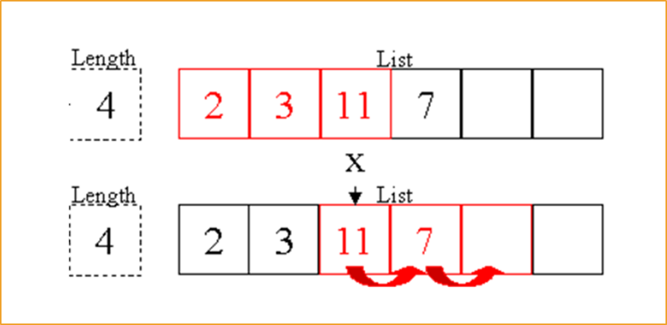
List Algorithms
Subset, Largest N elements, etc

Slide 23
Problem: Insertion Sort Using List
Read a list of integers and sort it using Insertion Sort into a result list.
5 3 4 1 2
1 2 3 4 5
11 872 673 1 2
1 1 6 7 2 4 1
11 52 43 12 1 6
6 1 12 43 52 11
Check your solution here: https://judge.softuni.bg/Contests/426/

Slide 24
Solution: Insertion Sort Using List (1)
// todo: read array
for (int arrIndex = 0; arrIndex < arr.Length; arrIndex++)
{
var inserted = false;
var currentElement = arr[arrIndex];
for (int listIndex = 0; listIndex < resultList.Count; listIndex++)
{
// continued on next slide...
Check your solution here: https://judge.softuni.bg/Contests/Practice/Index/426#5

Slide 25
Solution: Insertion Sort Using List (2)
var currentListElement = resultList[listIndex];
if (currentElement <= currentListElement)
{
inserted = true;
resultList.Insert(Math.Max(0, listIndex), currentElement);
break;
}
}
if (!inserted)
{
resultList.Add(currentElement);
}
} //todo: print resulting list
Check your solution here: https://judge.softuni.bg/Contests/Practice/Index/426#5

Slide 26
Problem: Largest N Elements
Read a list of integers and print the 3 largest elements in descending order:
5 3 4 1 2
3
5 4 3
11 872 673 1 2
2
872 673
11 52 43 12 1 6
4
52 43 12 11
Check your solution here: https://judge.softuni.bg/Contests/Practice/Index/426#6

Slide 27
Solution: Largest N Elements
var arr = Console.ReadLine()
.Split().Select(int.Parse).ToArray();
var n = int.Parse(Console.ReadLine());
// todo: sort array (in descending order)
for (int i = 0; i < n; i++)
{
largestNElements.Add(arr[i]);
}
Console.WriteLine(string.Join(" ", largestNElements));
Check your solution here: https://judge.softuni.bg/Contests/Practice/Index/426#6

Slide 28
List Algorithms – Exercises
Live Exercises in Class (Lab)

Slide 29
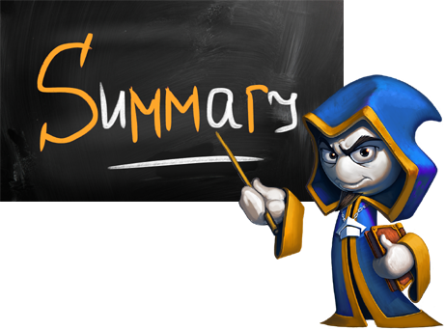
Summary
We can search inside an array and manipulate its elements
We can sort elements using various sorting algorithms
We can use lists to solve problems which require more complex logic than arrays can offer

Slide 30







Arrays
https://softuni.bg/courses/programming-fundamentals

Slide 31
License
This course (slides, examples, demos, videos, homework, etc.) is licensed under the "Creative Commons Attribution-NonCommercial-ShareAlike 4.0 International" license
Attribution: this work may contain portions from
"Fundamentals of Computer Programming with C#" book by Svetlin Nakov & Co. under CC-BY-SA license

Slide 32





Trainings @ Software University
Software University Foundation – softuni.org
Software University – High-Quality Education, Profession and Job for Software Developers
softuni.bg
Software University @ Facebook
facebook.com/SoftwareUniversity
Software University Forums – forum.softuni.bg

